Slide 1

Group ID: 7
Mini Project Final Presentation
on
“ Information Extraction using Convolutional Neural Networks ”
Under the Guidance of :-
Dr. Udit Kumar Chakraborty
Associate Professor
Computer Science and Engineering
Group Members :-
Mihir (201600045)
Chandni Agarwal (201600052)
Sweta Agarwal (201600091)

Slide 2
CONTENT
Abstract 7. Experimental Results
Introduction 8. Conclusion
Literature Survey 9. Limitations & Future Scope
Problem Definition 10. Gantt Chart
Solution Strategy 11. References
Design

Slide 3
ABSTRACT
Information Extraction has been one of the intriguing tasks of Natural Language Processing (NLP).
Text summarization is a technique of briefing a large text document by extracting its significant information.
The project aims at using Convolutional Neural Network(CNN) for extraction of important information from a large text document.
It is expected that acceptable results will be obtained using CNN and that will be much efficient in terms of both accuracy as well as computational cost.

Slide 4
INTRODUCTION
The amount of information available today is huge. Moreover, with the spread of internet, it has been easy to share and avail any information.
Although, data is available in abundance, it is hard to find whether it is reliable or not.
Text summarization is a process by which a large document can be expressed by comparatively smaller one, pertaining significant information that was conveyed by the original document.
It involves both Information Retrieval and Information Filtering.
Text summarization can be further categorized as extractive text summarization and abstractive text summarization.

Slide 5
INTRODUCTION
The method proposed in this project considers the fact that in this era, the data is available in abundance but computational capacity is limited.
Thus an approach with acceptable computational cost and efficient result using Convolutional Neural Network (also known as CNN) is proposed.
The main idea of using CNN for Information Extraction is to reduce the computational complexity that is offered by traditional approaches.
Information Extraction have found its uses in language translation, sentiment analysis, spam filtering and other NLP tasks.

Slide 6
LITERATURE SURVEY
SL. No. | Author | Paper and Publication Details | Findings | Relevance to the project
1. | T Mikolov, K Chen, G Corrado, J Dean | Efficient estimation of word representations in vector space -arXiv preprint arXiv:1301.3781 (2013). | Two novel architectures proposed for word embedding. The architecture saves contextual similarities, analogies and linear regularities. | It helped by directing towards a path to numerically represent the text document with its semantical meaning preserved.
2 | T Mikolov, I Sutskever, K Chen, GS Corrado | Distributed Representati ons of Words and Phrases and their Compositio nality - Advances in neural information processing systems. 2013. | Elaborates the working of one of the said novel architectures, namely, Skipgram architecture proposed in the above work. It expresses that the model gives high quality word vectors, elaborates the working of thee model | It helped understand the working of PVDBOW (equivalent to Skip-gram) architecture for its extended embedding technique of doc2vec.

Slide 7
LITERATURE SURVEY
SL. No. | Author | Paper and Publication Details | Findings | Relevance to the project
3. | Kim, Yoon . | Convolutional neural networks for sentence classification. - arXiv preprint arXiv:1408. 5882 (2014 ). | Describes how a convolutional neural network is used to train pre - trained word vectors for sentence -level classification. Vectors trained using continuous bag of words architecture. | It helped with classification of sentences in accordance to the pre -trained classes using CNN
4. | Kishore Papineni, Salim Roukos, Todd Ward, and Wei -Jing Zhu | BLEU: a Method for Automatic Evaluation of Machine Translation - Proceeding s of the 40th annual meeting on association for computatio nal linguistics. Association for Computatio nal Linguistics, 2002. | BLEU (bilingual evaluation understudy) is an algorithm for evaluating the quality of text which has been machine generated. | It helped with the evaluation of generated summary against human generated summary.

Slide 8
PROBLEM DEFINITION
The information is available in large volume and thus it is hard to know even about the authenticity of the information.
Traditional approaches are employed to perform this information extraction but can be computationally heavy.
The efficiency of the Traditional Algorithm was measured based on the output generated from data and was not robust due to limited availability of data.
But in the present era, where data is available in abundance, the computational power is limited.

Slide 9
SOLUTION STRATEGY
Split document into the list of its composite sentences and design classes.
Classes are to be converted to vectors using embedding technique of Doc2Vec.
Using CNN, the included sentence is to be mapped to one of the customized classes.
From the mapped list of sentences, the sentence that appears first in the document is added to the target extracted information.
Using the corresponding class the steps are to be repeated till the end of document is reached.

Slide 10
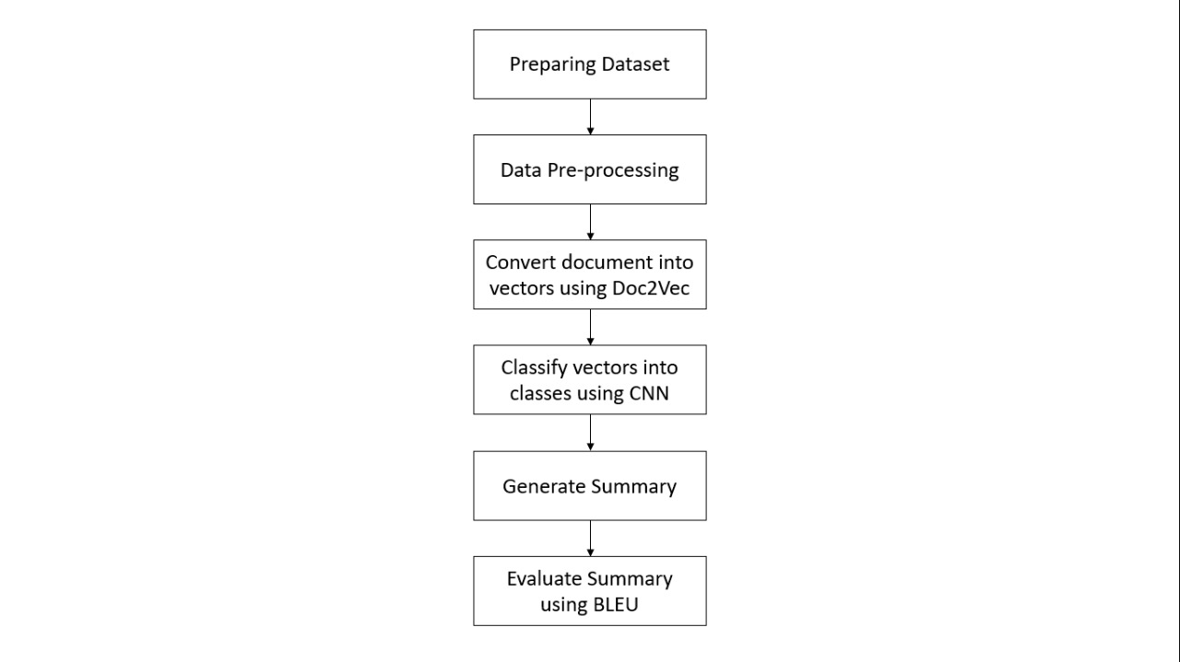
DESIGN
Figure 1: Flow Diagram of Solution Strategy

Slide 11
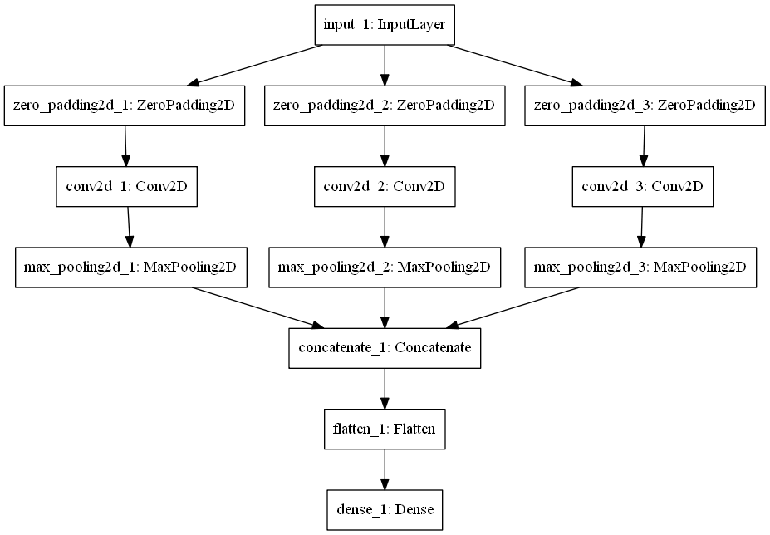
DESIGN
Figure 2: CNN model for World War II dataset

Slide 12
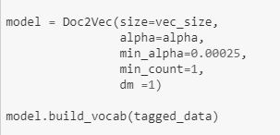
EXPERIMENTAL RESULTS
For vectorization:

Slide 13
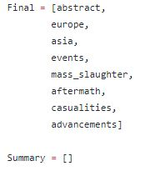
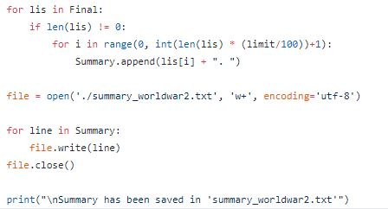
EXPERIMENTAL RESULTS
For classification and selection:

Slide 14
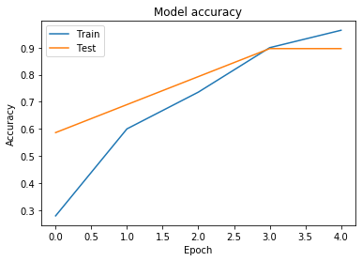
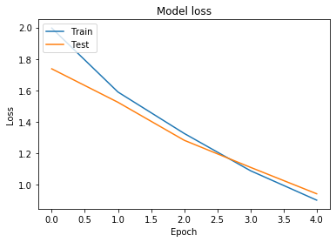
EXPERIMENTAL RESULTS
Visual Representation of Model Behaviour:
Figure : Model Graph for World War II

Slide 15
CONCLUSION
A Text summarizer was created using Convolutional Neural Network.
The Text summarizer created was specific for different domains .
Results verified using BLEU.
The created summarizer generates acceptable results with low computational complexity.

Slide 16
LIMITATIONS & FUTURE SCOPE
Using CNN makes the architecture highly supervised.
Architecture needs to be trained by classes specific to the domain of the document.
Dataset for this training needs to be created, classes need to be defined.
Spending some more time and refining the model, architecture is expected to summarize any document specific to at least one domain without use of any exhaustive algorithm.

Slide 17
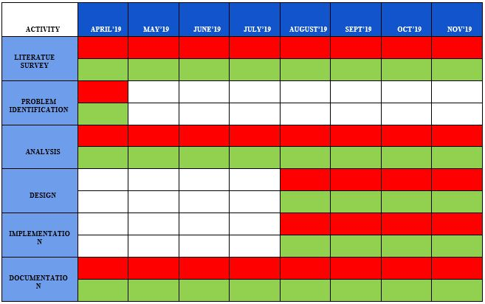

GANTT CHART
PROPOSED WORK
ONGOING ACTIVITY
ACHIEVED WORK

Slide 18
REFERENCES
[1] Mikolov, Tomas, et al. "Efficient estimation of word representations in vector space.”arXiv preprint arXiv:1301.3781(2013).
[2] Mikolov, Tomas, et al. "Distributed representations of words and phrases and their compositionality." Advances in neural information processing systems. 2013.
[3] Kim, Yoon. "Convolutional neural networks for sentence classification." arXivpreprint arXiv:1408.5882(2014).
[4] Papineni, Kishore, et al. "BLEU: a method for automatic evaluation of machine translation." Proceedings of the 40th annual meeting on association for computational linguistics. Association for Computational Linguistics, 2002.

Slide 19
THANK YOU

